Slide 1
Eastern Partnership Roadmap Monitoring Victor Cotruta Executive Director REC Moldova Eastern Partnership Civil Society Forum Working Group 3 meeting, Chisinau, 9 July 2013

Slide 2
More for more: verifiable indicators?
Eastern Partnership:
A Roadmap to the autumn 2013 Summit
“Progress towards reforms will be assessed according to specific criteria which reflect the commitments already undertaken through the existing agreements between the EU and partner countries including those in ENP Action Plans/Association Agendas. The EU will take a holistic view of its relations with partners, including efforts to tackle instability and conflict in the region.”

Slide 3
General framework
The Roadmap’s bilateral table focuses on the following main jointly agreed objectives:
political association and economic integration
enhanced mobility of citizens in a secure and well managed environment
strengthened sector cooperation.

Slide 4
Objectives for CIVIL SOCIETY FORUM
Reforms that will further democratic values and respect of human rights.
Furthering bilateral and multilateral co-operation and European integration through increasing transparency in the relationship between the EU and the EaP countries.
Improving efficiency, co-ordination, and implementation of policies towards European integration.
A new roadmap, or an alternative to a roadmap, for the coming two years - based on a design derived from the conclusions and recommendations emanating from the CSF monitoring.

Slide 5
Challenges
Monitoring a snapshot (May 2012 – autumn 2013) before October 2013 while demonstrating independent, empirical-based, expert evaluation
Need to formulate clear, concise conclusions and recommendations
Need to be credible and timely, and bring new data and fresh analysis
Need to set the agenda for post-Vilnius summit

Slide 6
Methodological questions
Need for simplicity - as roadmap very open-ended
Outcomes in roadmap often not very specific (very often "Continuous action", so hard to measure….slightly more specific on multilateral roadmap interestingly …)
Often necessary to look at individual country action plans
Need to really prioritise which objectives are most important in democratic development of given country, e.g:
DCFTA
WTO accession for some countries
intellectual property rights
customs cooperation
approximate taxation systems
SME legal framework

Slide 7
Audiences and outputs
Targets
national governments
European Commission and EEAS
European Council and EU member states
Outputs
national assessments,
comparative assessments,
multilateral co-operation assessments
policy briefs and two-page summaries for EaP and EU officials
national and international op-eds

Slide 8
Three pillars to monitoring
Independent verification of fulfilment of objectives set out in roadmap (including cross-checking of European Commission progress reports and national government progress reports)
Analysis of effectiveness of use of EU funding (ENPI/CIB/budget support), and of dual-track funding challenge (where EU funding goes to governments and to civil society but without dialogue and co-ordination between the two recipient parties in-country)
Monitoring of inclusiveness and transparency of policymaking and implementation (including both openness to CSF, and responsiveness to initiatives and policy proposals from civil society)

Slide 9
Matrix for monitoring
1. The roadmap’s stated objective, and perceptions of the relevance of the stated objectives to country needs
2. Indicators used to assess the fulfilment of the objective
3. Recommendations for reforms/policies
4. Recommendations for adjustments to EU funding policies (“more for more”) and flagship initiatives

Slide 10
Timeline
The aim should be to have:
Interim country assessments ready by the end of June (ahead of the 22 July EAP Foreign Ministers (28+6) meeting, and
A full evaluation by late September ahead of the CSF Forum meeting and Vilnius summit.

Slide 11
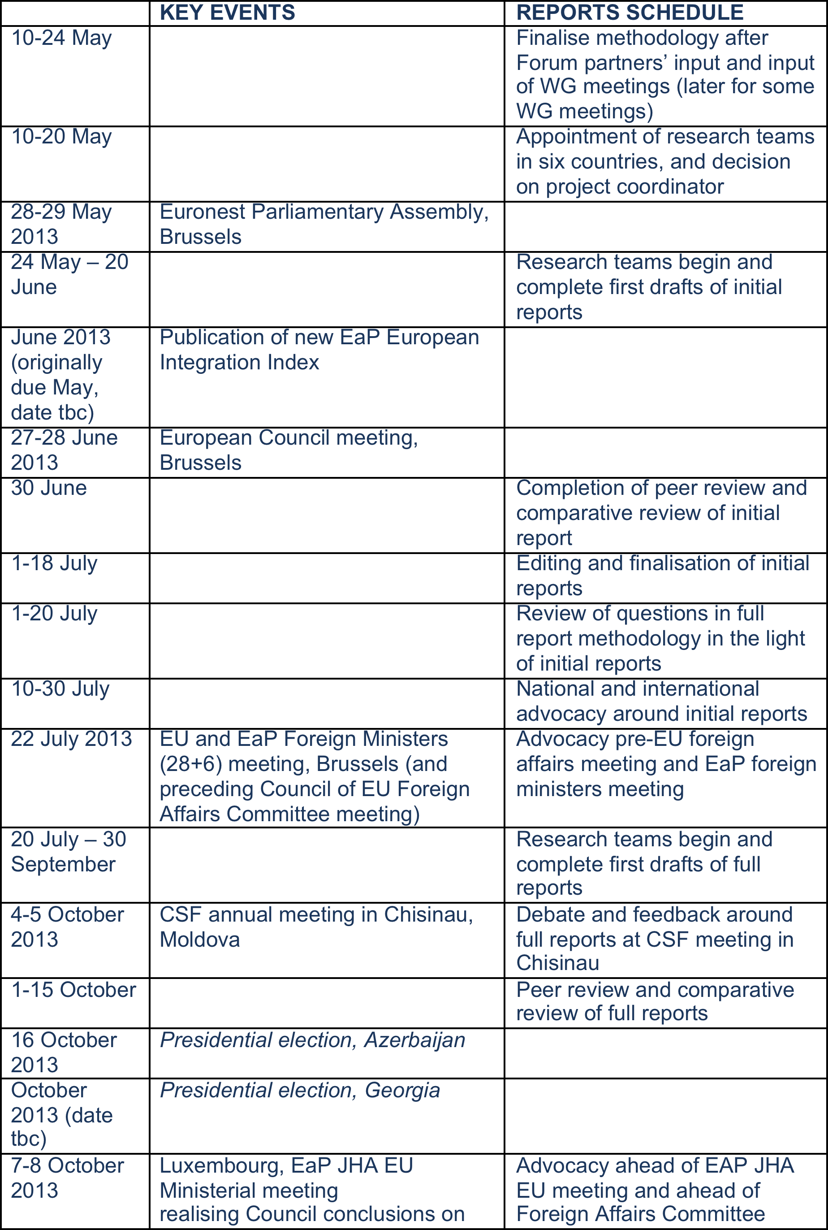

Slide 12
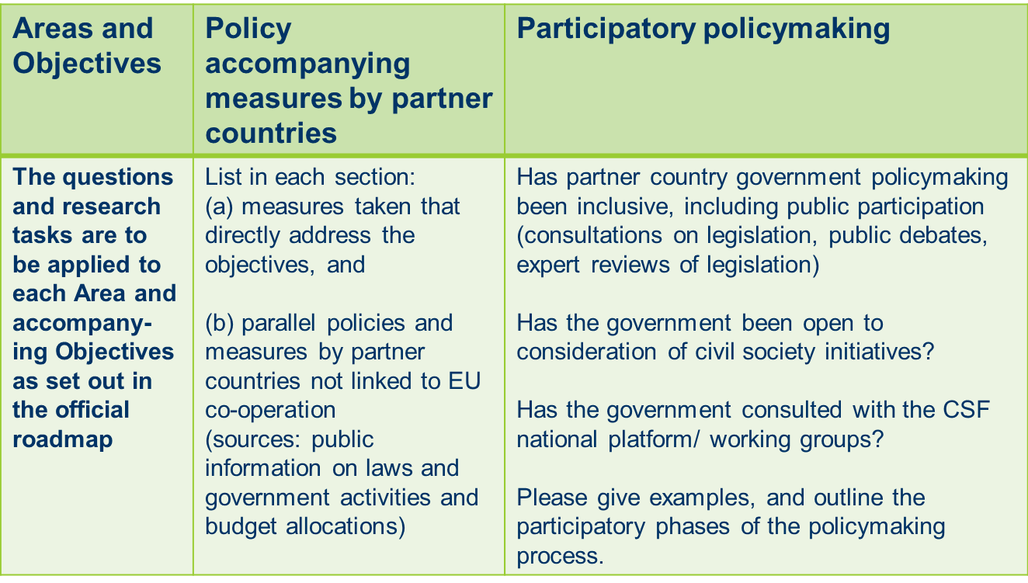
Roadmap monitoring – initial reports – July 2013
Environment, Climate Change and energy security
Monitoring the implementation of ENP in the field of sustainable development and environment protection, providing the relevant recommendations, shadow reports (Georgia, Moldova, Belarus)
b) Monitoring energy policies and challenges for formation of sustainable energy system, including development of renewables, Energy efficiency, Climate Change mitigation and adaptation issues, natural disasters management and Eco refugees (Georgia, Moldova, Ukraine, Belarus)
c) Work to ensure public participation in decision making and implementation of Aarhus Convention

Slide 13
Initial outputs
The outputs (including online dissemination) at the end of June/early July 2013 will comprise:
• Two-page summaries for government officials in EaP countries of the main successes, failures, or stagnant areas (in terms of roadmap objectives set)
• Two-page summaries on each country for EU and EU member government officials

Slide 14
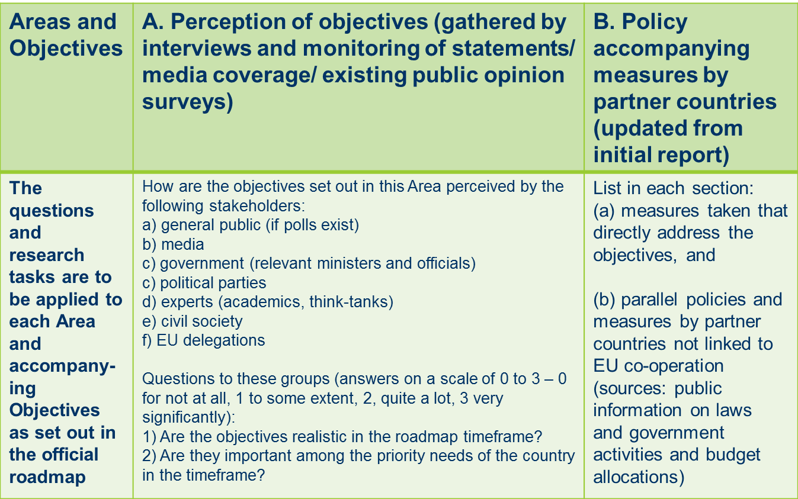
Roadmap monitoring – full reports – October 2013

Slide 15
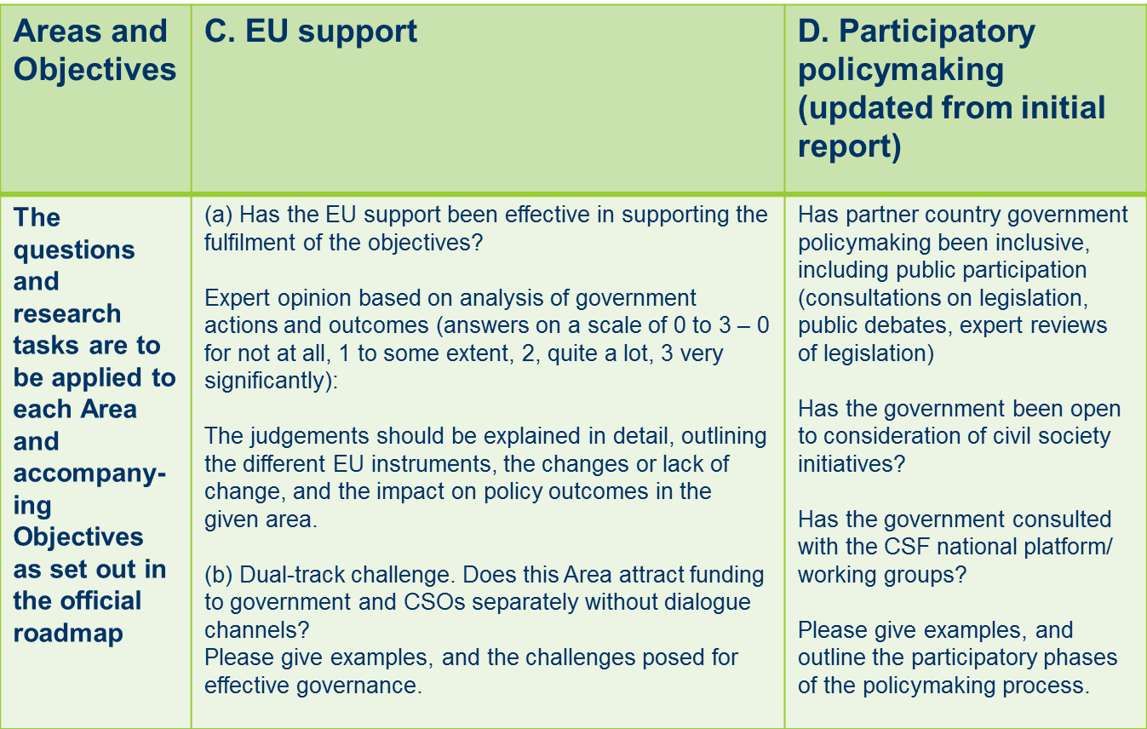
Roadmap monitoring – full reports – October 2013

Slide 16
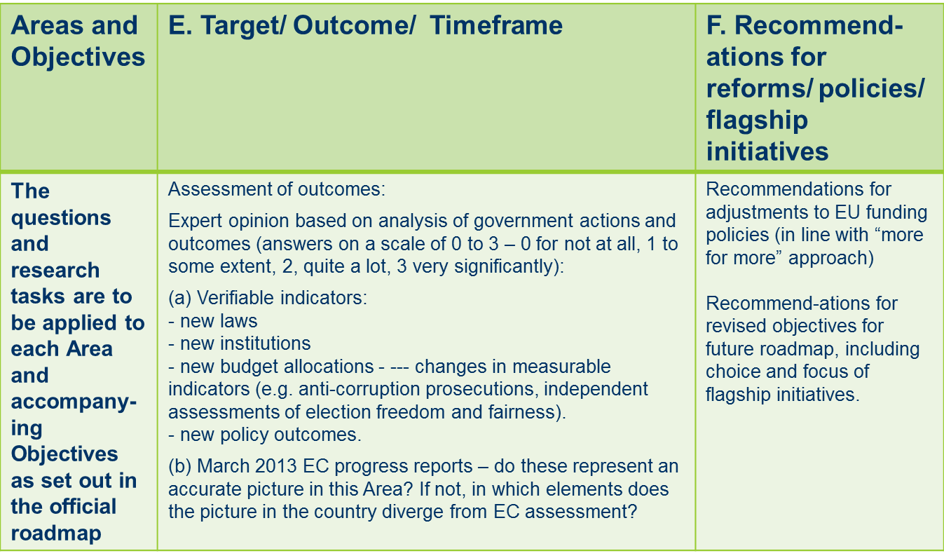
Roadmap monitoring – full reports – October 2013

Slide 17
Civil society engagement
Did the partner country government willingly engage with civil society actors who can take up the role as independent watchdogs, monitoring and evaluating the effective use of public resources?
Did the EU delegation and European Commission work to bring together government and civil society actors to engage in a policy dialogue?
If it took place, was dialogue between the partner country government and civil society actors effective in improving participatory policymaking?
Have trilateral for a been established for regular consultations between the respective partner government, the EU delegation, and representatives of the national platforms of the Civil Society Forum to consider, assess, and monitor implementation of, policy developments in relations between the EU and the respective Partner countries?

Slide 18
Civil society engagement …
Are public consultations carried out to reach out to all sectors of civil society and the wider public?
Are bilateral agreements between the EU and the partner country government subject to clear, publicly available timetables for each stage in the process - so that the public and civil society can exercise an effective watchdog function of monitoring the procedure of first policymaking, and then policy implementation?
Is access to policy drafts made fully public at key stages of the decision-making process to ensure adequate time is provided for feedback from civil society actors and the wider public?

Slide 19
Scoring civil society engagement
For each question, the researchers should answer “Yes” or “No”.
For each question, the researchers should outline the sources used, any challenges encountered in answering the questions, and they should set out the reasons for their response.
The methodology expert will then code the responses and return scores for all six partner countries to the local researchers, enabling cross-review between the different country researchers. Scores could then be adapted to eliminate discrepancies and misunderstandings.
Questions answered with yes or no will be coded 1 = yes or positive and 0 = negative, or 0.5 if clarity cannot be obtained. The scores will be determined through a linear transformation.

Slide 20
Outputs from full reports
The outputs (including online dissemination) in September/early October 2013 will comprise (as well as op-eds for the media):
Two-page summaries for government officials in EaP countries
Two-page summaries on each country and a two-page comparative summary for EU and EU member government officials
Six country reports, in English and local languages, including the tables set out above, and a comparative report in English and local languages
Policy briefs setting out the design of the new roadmap and/or key policy reform proposals.

Slide 21
WGs involvement
Initial monitoring:
From the WGs, it is more through the research teams for e.g. WG3 experts in the respective countries to give their input (different experts being interviewed by the researchers; others as peer reviewers)

Slide 22
WGs involvement…
For the final monitoring to be ready for the Vilnius summit, we will be tackling also the multilateral part of the roadmap, and again there will be a role, namely:
WG experts in respective countries to give input to country research teams (through being interviewed by researchers; others as peer reviewers)
Research teams will contact WG experts also on the
multilateral roadmap objectives and expectations

Slide 23
WGs involvement…
In order to have a better timeframe for the full report, Jeff from PASOS will also be in touch directly with the WG co-ordinators to talk through how to involve the WGs more - so that drafts are with them early enough:
for cross-checks of comparative information on the different countries;
to help the WGs plan advocacy around the reports, e.g. WG statements to intergovernmental audiences, op-eds in national and international media
to serve as input into WG priority-setting, e.g. as indication of priority areas where extra WG efforts can make a difference; or for drawing attention to major failings by different EaP country governments or EU-EaP relations.

Slide 24

Jeff Lovitt
Executive Director
PASOS
Tesnov 3, 110 00 Praha 1, Czech Republic
www.pasos.org
Tel/Fax: +420 2223 13644
Mobile: +420 7315 17224
jefflovitt@pasos.org

Slide 25
Thank you!
Questions?
Victor Cotruta
Executive Director
REC Moldova
31 Mateevici, 2009 Chisianu, Republic of Moldova
www.rec.md
Tel/Fax: +373 22 240998
Mobile: +373 69 125345
victor@rec.md

